Slide 1

Currency Pairs Close Price Prediction Using LSTM (EURUSD and EURJPY )
Wannisa Cheamsiri
6538134
10 December 2023

Slide 2
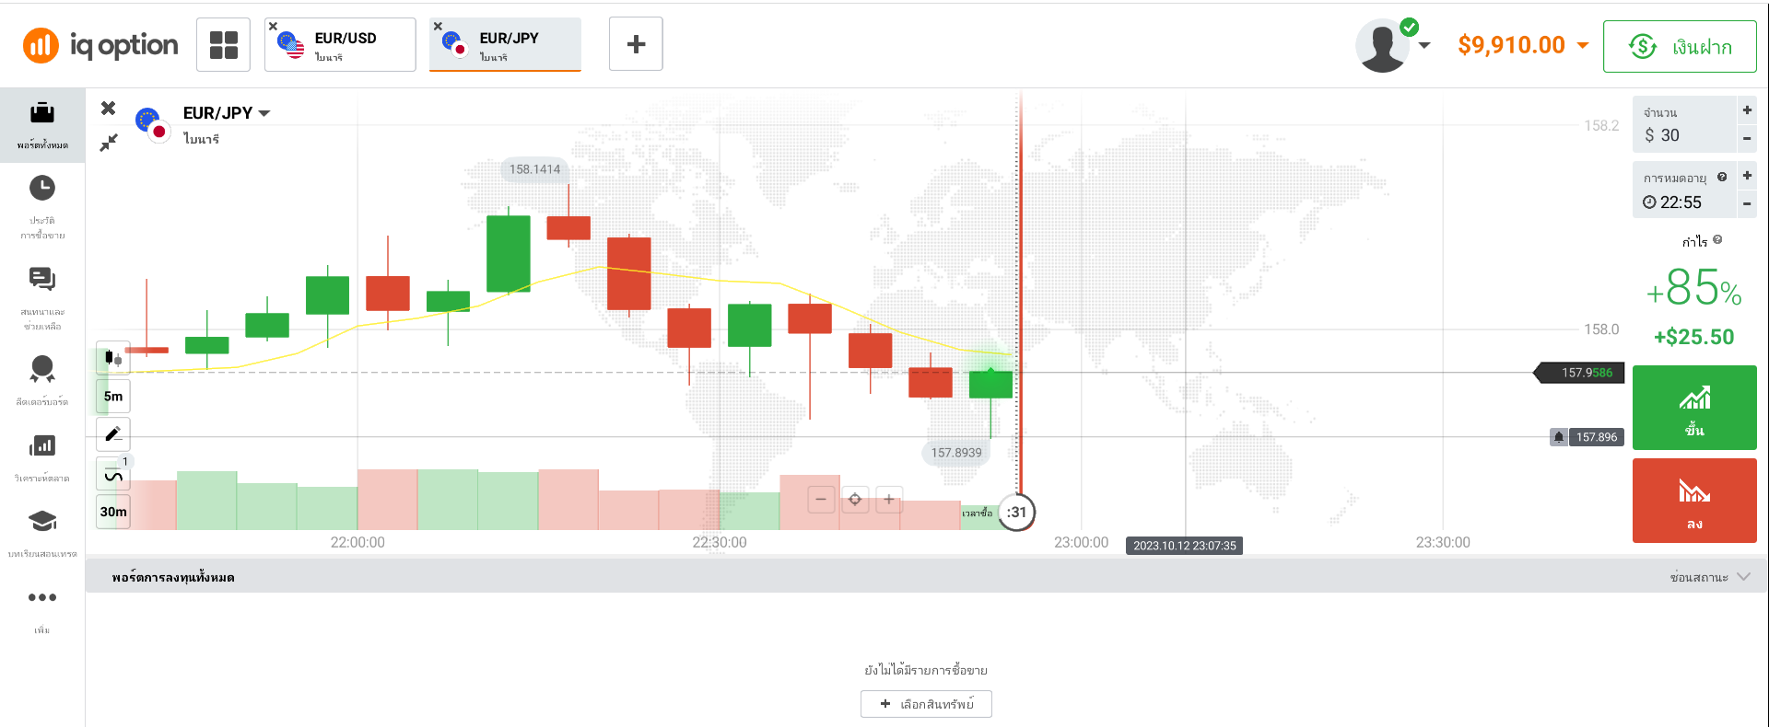
Introduction
Binary options are a form of financial derivative where traders speculate on the price movements of underlying assets, such as stocks, currency pairs, commodities, or indices. They are termed "binary" options due to the existence of only two potential outcomes: a fixed profit if the trader's prediction is accurate, or a loss of the initial investment if the prediction is incorrect.
This study aims to introduce an innovative model using Long Short-Term Memory (LSTM) to forecast the closing prices of the EURUSD and EURJPY currency pairs. The objective is to predict whether the price of the underlying asset will increase (referred to as a "call" option) or decrease (referred to as a "put" option) within a specified 5-minute time frame.
Up/Down ?

Slide 3

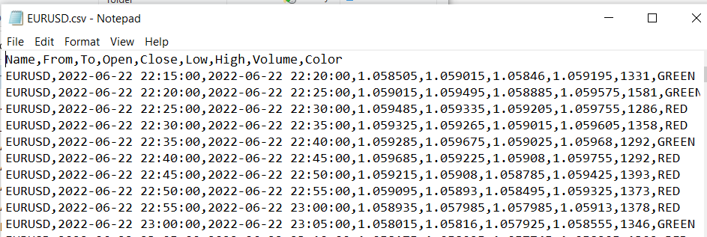
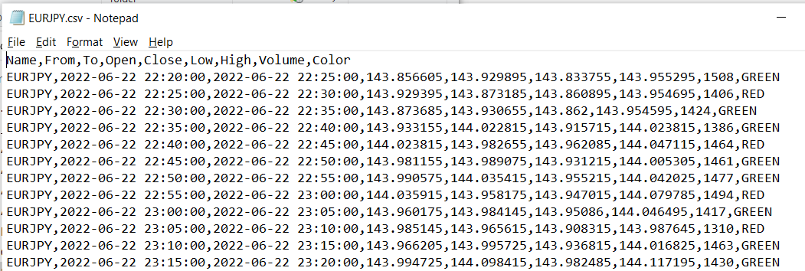
Method
Data Preparation
Exploratory Data Analysis (EDA)
Preprocess
Learning Technique
Experiment Result
Data source was queried data 5 minutes time frame over iqoptionapi using python by target two currency pairs as “EURUSD” and “EURJPY” retrieve data from 1 year ago, data consisting of Currency Pair Name, Date/Time From, Date/Time To, Open Price ,Close Price ,Low ,High ,Volume , and Color.

Slide 4
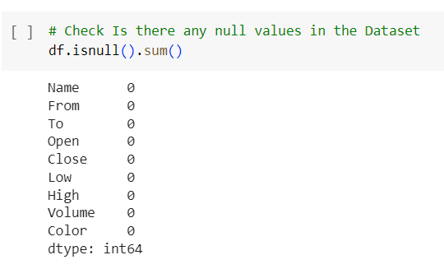
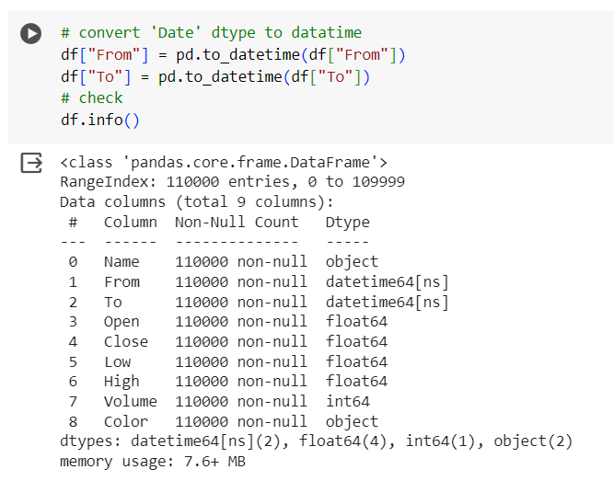
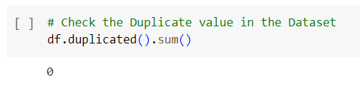
Method
Data Preparation
Exploratory Data Analysis (EDA)
Preprocess
Learning Technique
Experiment Result
1. Inspect any missing values, duplicate, or errors.
2. Transform data type such as date from object to datetime data type

Slide 5
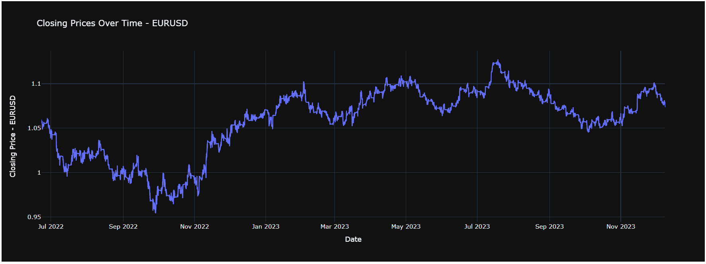
Method
Data Preparation
Exploratory Data Analysis (EDA)
Preprocess
Learning Technique
Experiment Result
1. Analysis closing price trend

Slide 6
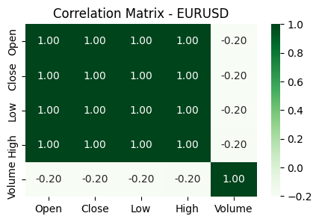
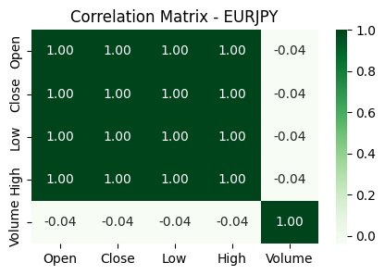
Method
Data Preparation
Exploratory Data Analysis (EDA)
Preprocess
Learning Technique
Experiment Result
2. Visualize the Correlation Matrix
Indicates that the Close Price has a strong positive correlation with Open, High, and Low, but a weak negative correlation with Volume. Also indicates that the Open, High, and Low are highly correlated with each other

Slide 7
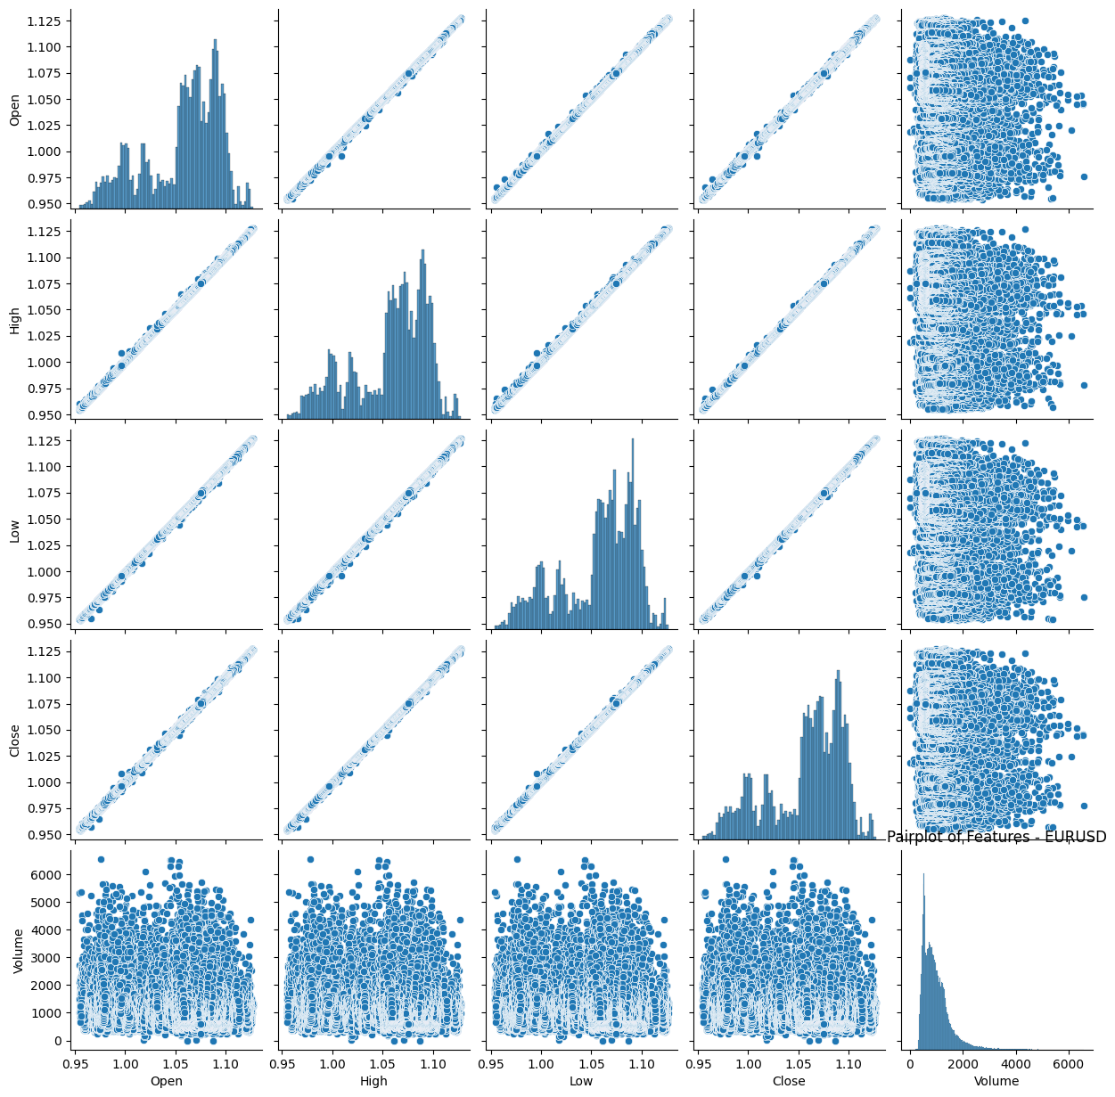
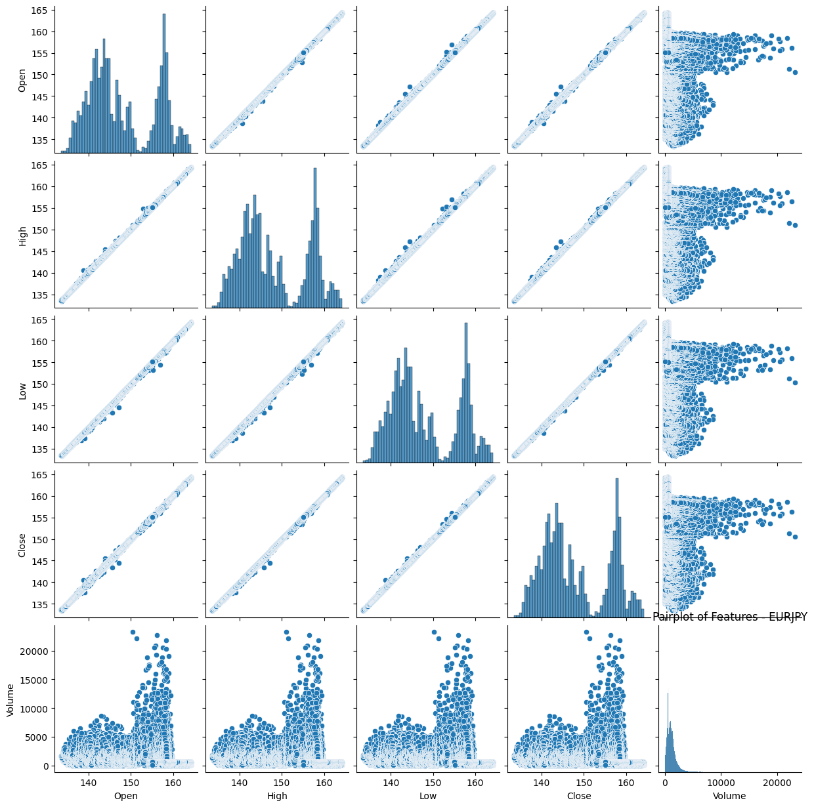
Method
Data Preparation
Exploratory Data Analysis (EDA)
Preprocess
Learning Technique
Experiment Result
3. Visualize the Pairplot of features
Indicates that the Open, High, and Low are strongly positively correlated with each other, with a linear relationship. Also indicates that the Volume feature is not strongly correlated with any of the other features

Slide 8
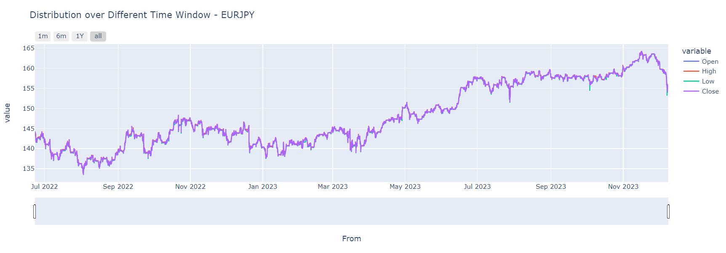
Method
Data Preparation
Exploratory Data Analysis (EDA)
Preprocess
Learning Technique
Experiment Result
4. Create a line chart using the dataset with two lines to explore High-Low and Open-Close in range 1 month, 6 months, and 1 year, or all data.

Slide 9
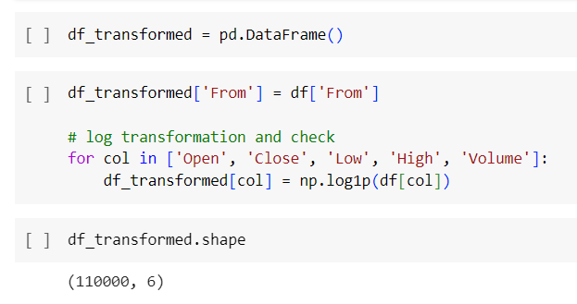
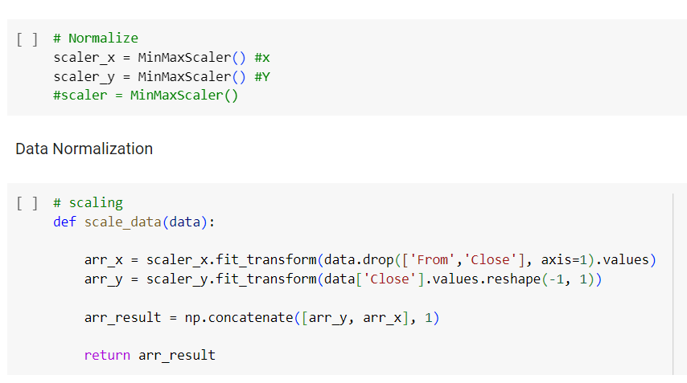
Method
Data Preparation
Exploratory Data Analysis (EDA)
Preprocess
Learning Technique
Experiment Result
1. Apply a logarithmic transformation. The logarithmic transformation is often used in data preprocessing to reduce the impact of outliers and to make the data more normally distributed.
2. Data Normalization using MinMaxScaler to rescale the features of a dataset to a standard scale

Slide 10
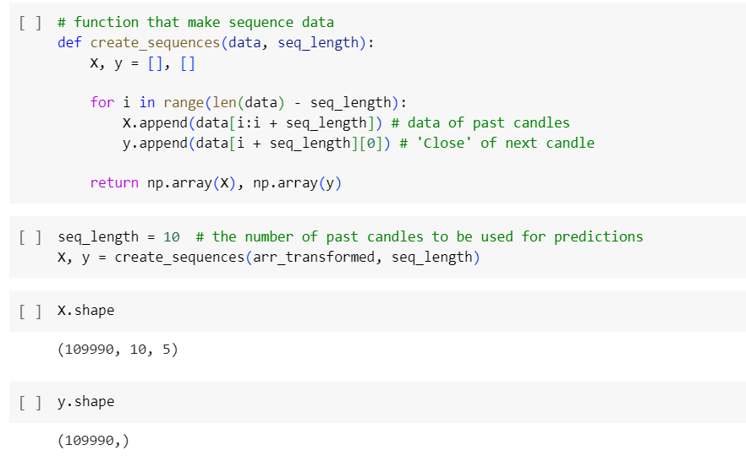
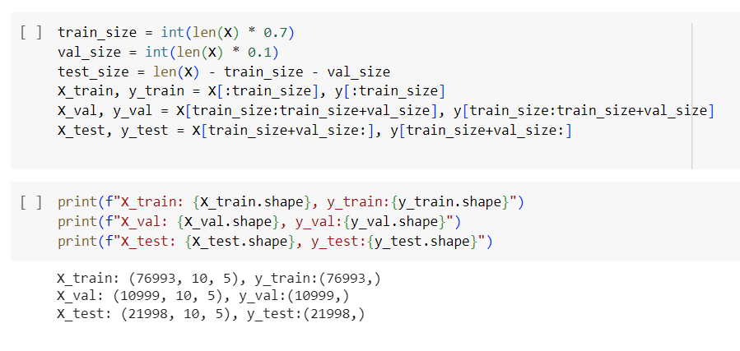
Method
Data Preparation
Exploratory Data Analysis (EDA)
Preprocess
Learning Technique
Experiment Result
3. Make sequence data, designed to use the closing price data from the last 10 candles to make predictions.
4. Data Splitting, divide the data into training set 70%, validation set 10%, and testing set 20%.

Slide 11
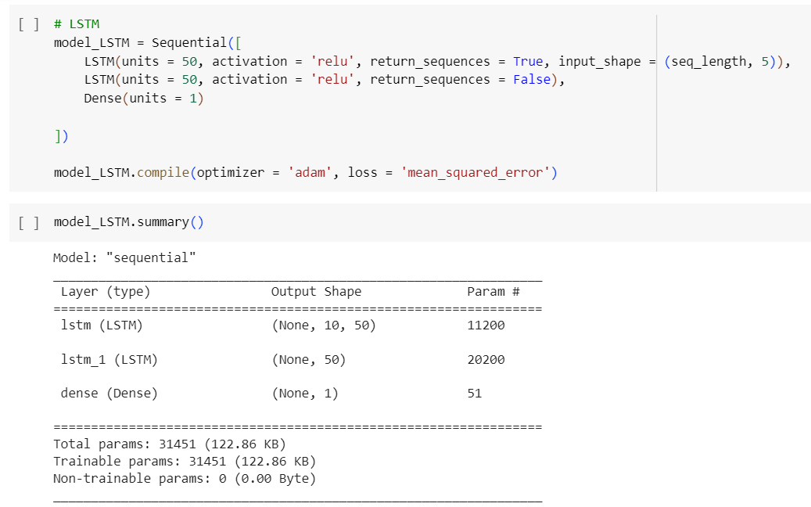
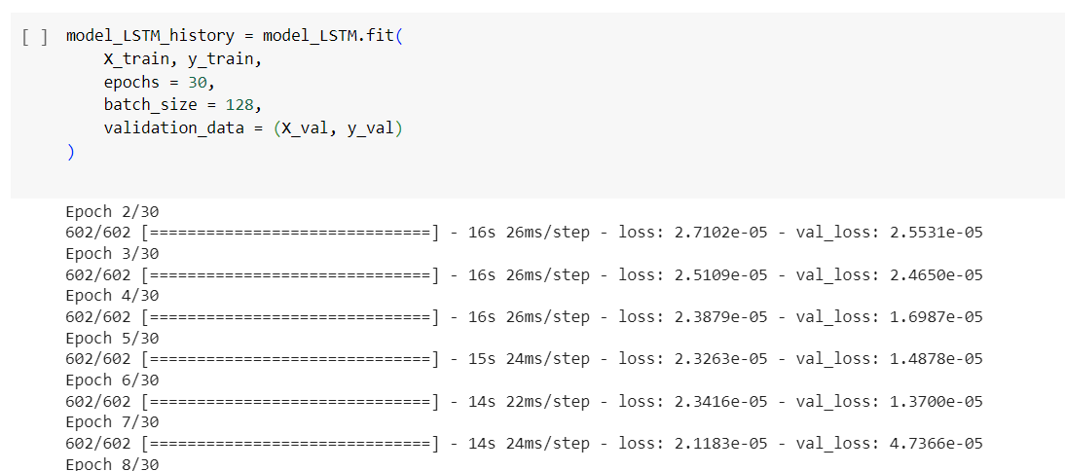
Method
Data Preparation
Exploratory Data Analysis (EDA)
Preprocess
Learning Technique
Experiment Result
1. Design Long Short-Term Memory (LSTM) model using Adam as optimizer and Mean Square Error to evaluate model performance.
2. Train 30 epochs, batch size 128.

Slide 12
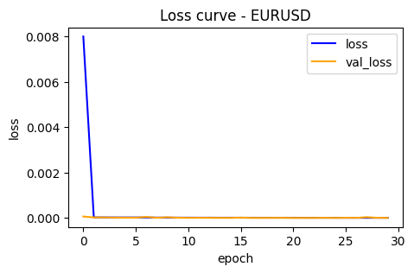
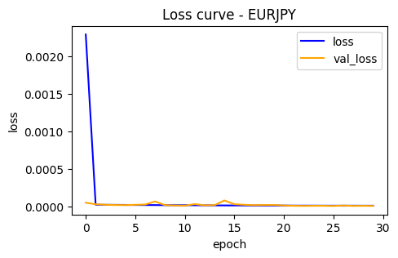
Method
Data Preparation
Exploratory Data Analysis (EDA)
Preprocess
Learning Technique
Experiment Result

Slide 13
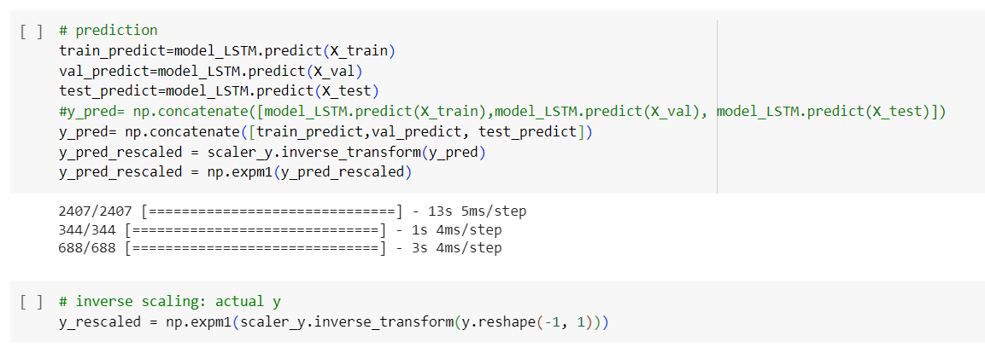
Method
Data Preparation
Exploratory Data Analysis (EDA)
Preprocess
Learning Technique
Experiment Result
3. Forecasting by applying the trained model to make predictions on train set, validation set, and test set as unseen. 4. Rescale the prediction data back to normal using the inverse_transform function of MinMaxScaler.

Slide 14
Method
Data Preparation
Exploratory Data Analysis (EDA)
Preprocess
Learning Technique
Experiment Result
1. Both EURUSD and EURJPY have low prediction errors (MAE, MSE, RMSE, MAPE, and MFE) and high R2 score indicates a strong relationship between the predictors and the target variable, indicating a good fit of the model to the data.
Evaluator | Currency Pairs EURUSD | Currency Pairs EURJPY
Mean Absolute Error (MAE) | 0.00175 | 0.00146
Mean Squared Error (MSE) | 4.96512 | 3.65036
Root Mean Squared Error (RMSE) | 0.00222 | 0.00191
R-squared (R2) | 0.99918 | 0.99904
Mean Absolute Percentage Error (MAPE) | 0.00259 | 0.00170
Mean Forecast Error (MFE) | 0.00141 | 0.00109

Slide 15
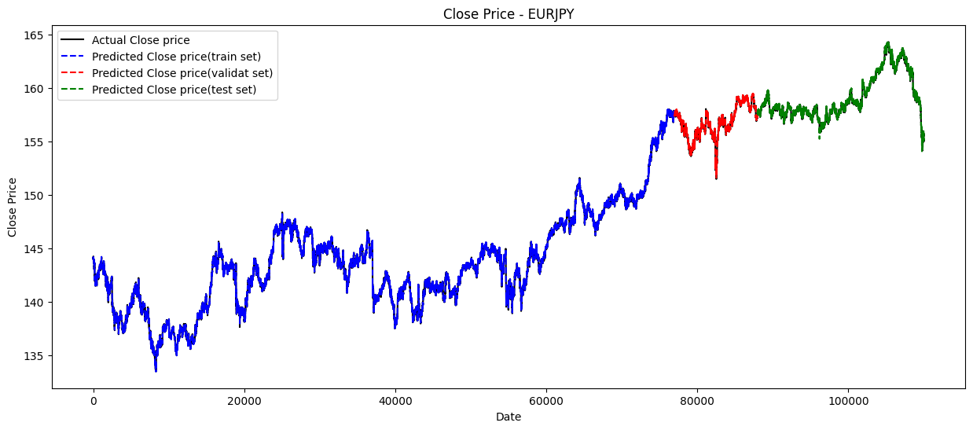
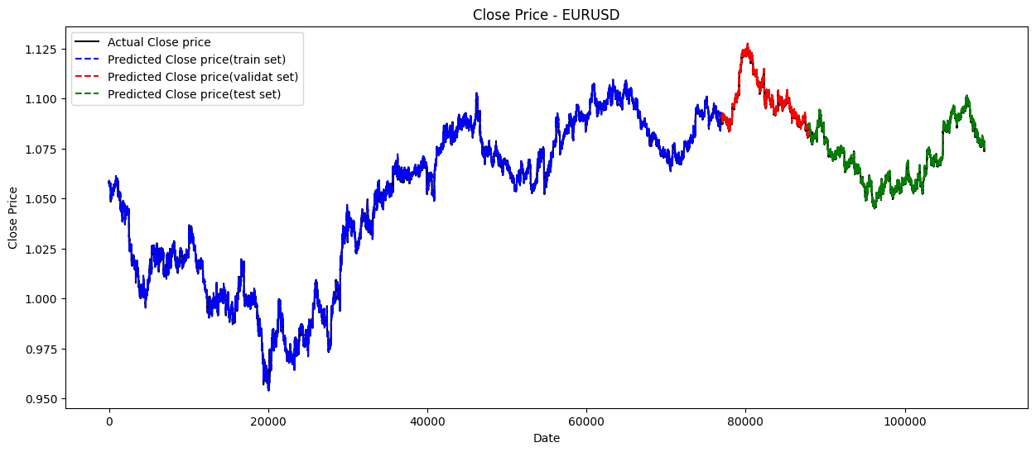
Method
Data Preparation
Exploratory Data Analysis (EDA)
Preprocess
Learning Technique
Experiment Result
2. The prediction data for EURUSD and EURJPY currency pairs demonstrates a close relationship with actual data, even when considering unseen test predictions.

Slide 16
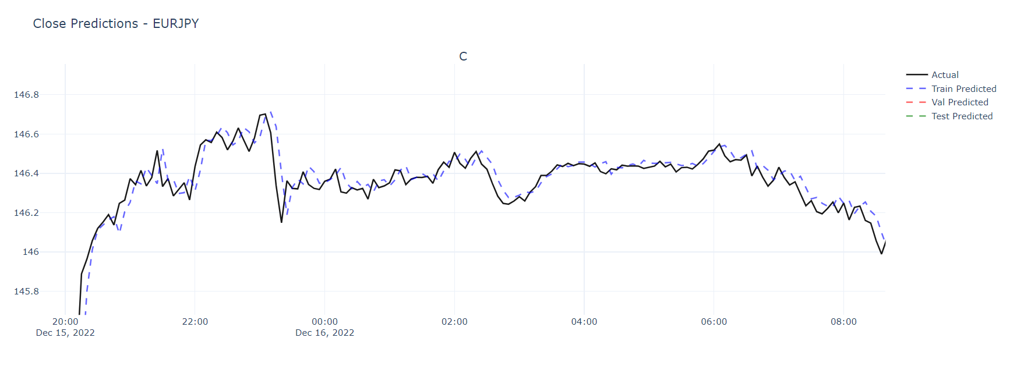
Method
Data Preparation
Exploratory Data Analysis (EDA)
Preprocess
Learning Technique
Experiment Result

Slide 17
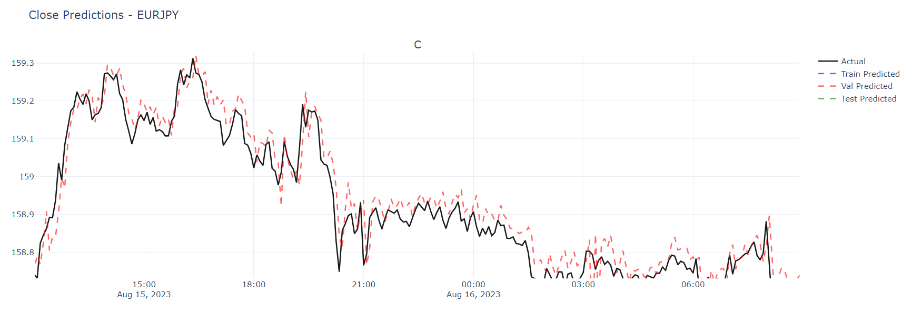
Method
Data Preparation
Exploratory Data Analysis (EDA)
Preprocess
Learning Technique
Experiment Result

Slide 18
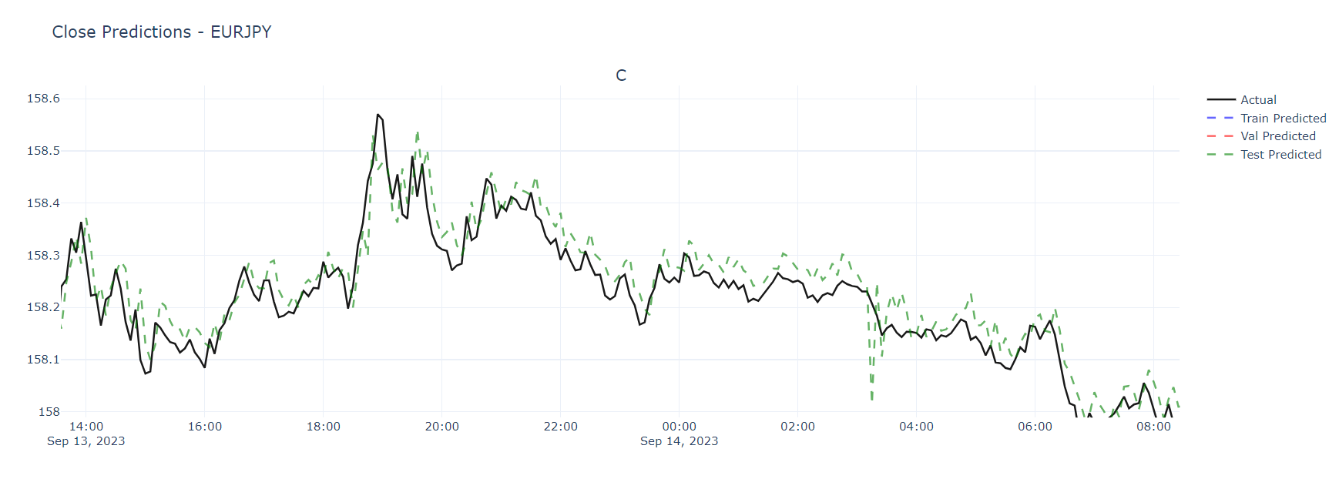
Method
Data Preparation
Exploratory Data Analysis (EDA)
Preprocess
Learning Technique
Experiment Result

Slide 19
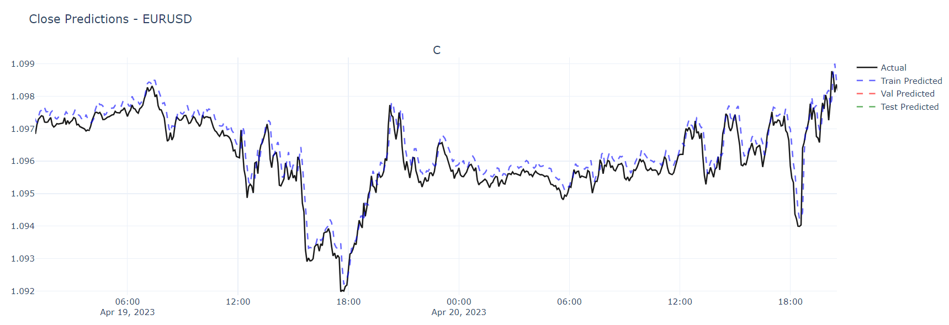
Method
Data Preparation
Exploratory Data Analysis (EDA)
Preprocess
Learning Technique
Experiment Result

Slide 20
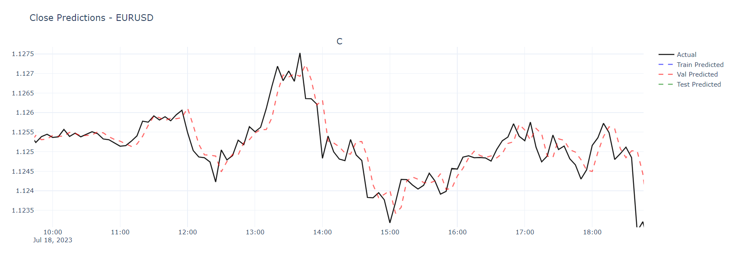
Method
Data Preparation
Exploratory Data Analysis (EDA)
Preprocess
Learning Technique
Experiment Result

Slide 21
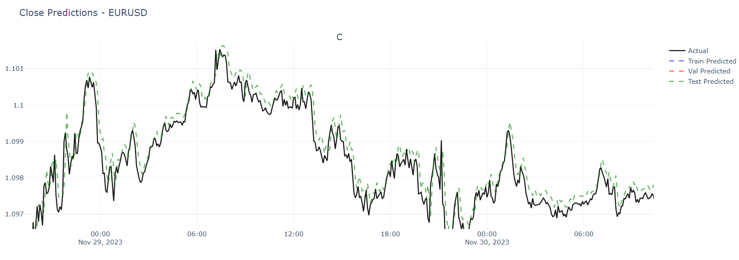
Method
Data Preparation
Exploratory Data Analysis (EDA)
Preprocess
Learning Technique
Experiment Result

Slide 22
Conclusion
The predictive model for the EURUSD and EURJPY currency pairs demonstrates high accuracy and precision.
The evaluation metrics, including the Mean Absolute Error (MAE), Mean Squared Error (MSE), Root Mean Squared Error (RMSE), R-squared (R2), Mean Absolute Percentage Error (MAPE), and Mean Forecast Error (MFE), indicate a strong performance of the model.
The R-squared value of EURUSD is 0.99918 and EURJPY is 0.99904 suggests that the model explains the variability of the response data around its mean exceptionally well.
The analysis of the EURUSD and USDJPY currency pairs from IQ Option sources, including forecasts, further supports the potential for informed trading decisions based on the predictive model's outcomes.
Future Work
To enhance the accuracy of the predictive model by integrate technical indicators such as moving averages (MA) and the relative strength index (SRI), will be use fore more feature extraction and model traning.

Slide 23

Thank you

